Slide 1

HOSPITALITY ANALYSIS

Slide 2

P658 HOSPITALITY ANALYSIS
GROUP-4 MEMBERS
MANJULA A SHINDHE
MIRZA SHAIKSHAVALI BAIG
K.RISHI VARMA
ROHITH RAMESH KULANGE
JEEVAN NARRA
MANSI S GITTE
RITISHA YADAV

Slide 3
SUMMARY
The hospitality analysis reveals a strong overall performance with total revenue of 1,709 million, driven primarily by weekday bookings and high demand for Elite and Premium room classes.
Occupancy and capacity utilization both stand at 58%, while a 25% cancellation rate indicates room for improvement in booking retention.
Atliq Exotica and Atliq Palace lead in revenue generation, while Atliq Seasons underperforms.
Weekly revenue shows steady trends with minimal fluctuations, suggesting a stable demand.
These insights highlight opportunities to reduce cancellations, enhance weekend appeal, and capitalize on high-performing hotels and room classes for revenue growth.

Slide 4
KPI’S
Total Revenue
Occupancy
Cancellation Rate
Total Booking
Utilize capacity
Trend Analysis
Weekday & Weekend Revenue and Booking
Revenue by State & hotel
Class Wise Revenue
Checked out cancel No show
Weekly trend Key trend (Revenue, Total booking, Occupancy)

Slide 5
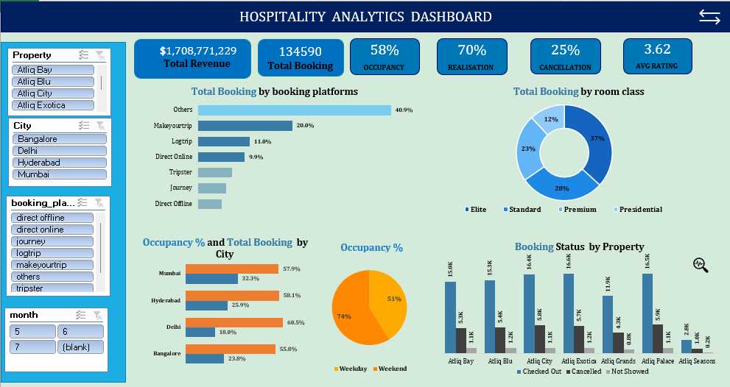
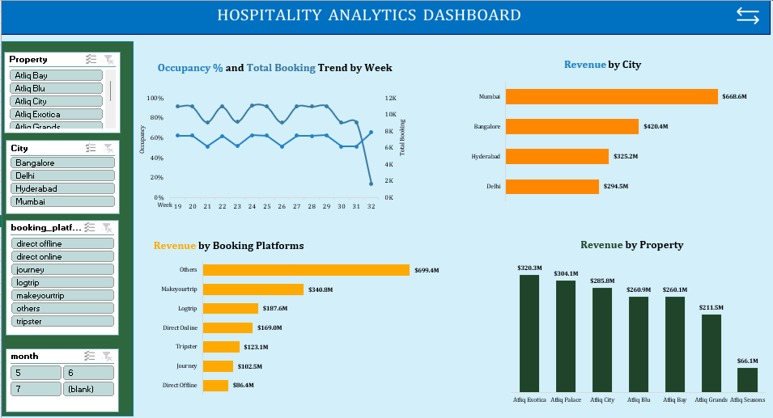
EXCEL DASHBOARD

Slide 6
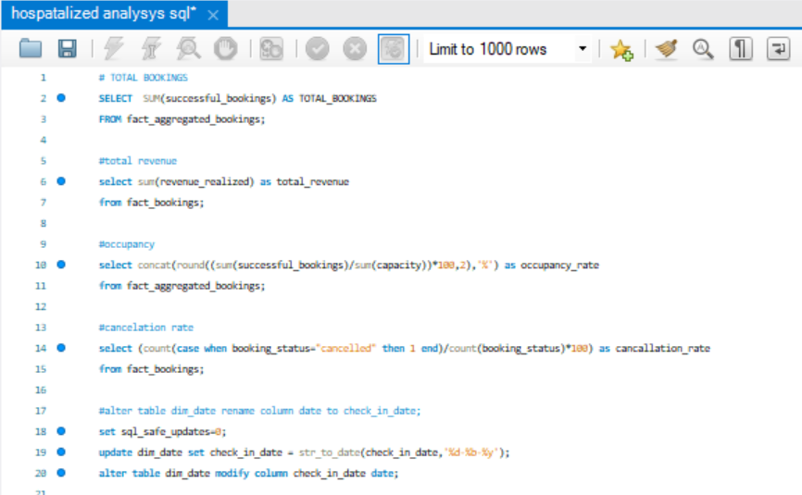
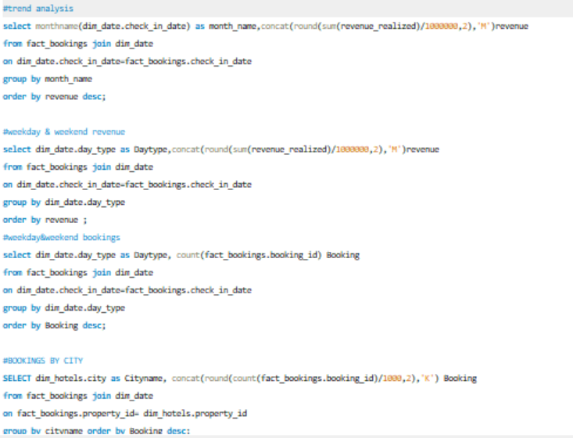
SQL COMMANDS

Slide 7
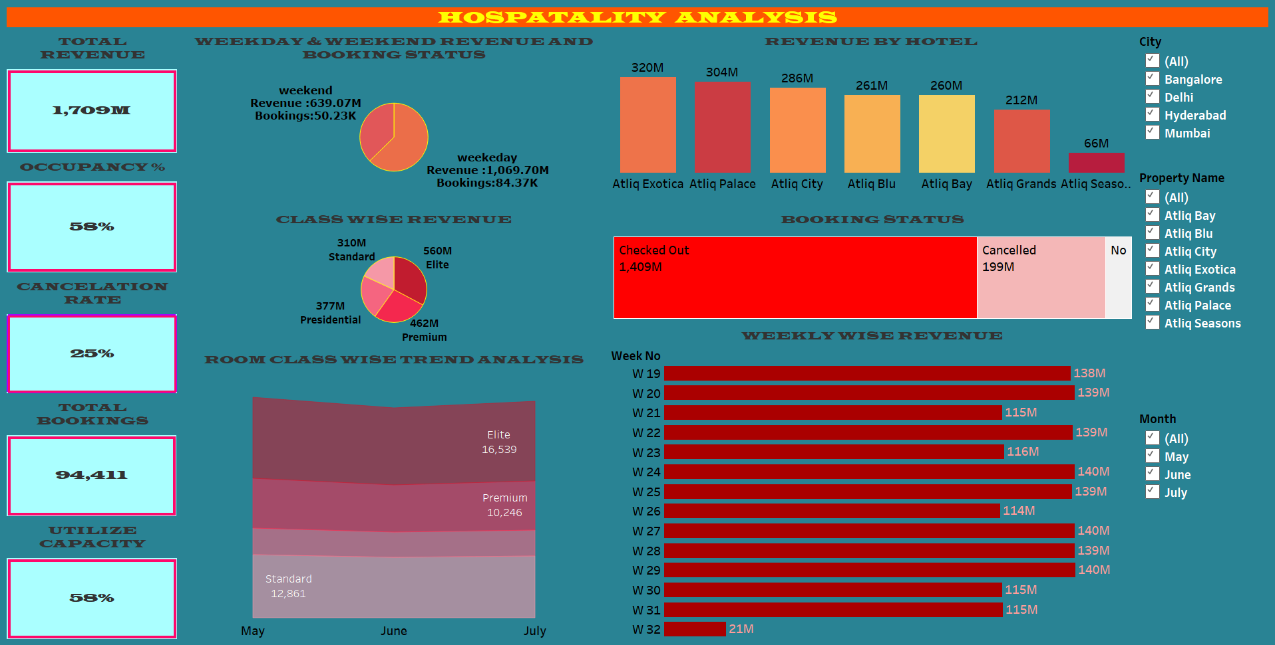
TABLEAU DASHBOARD

Slide 8
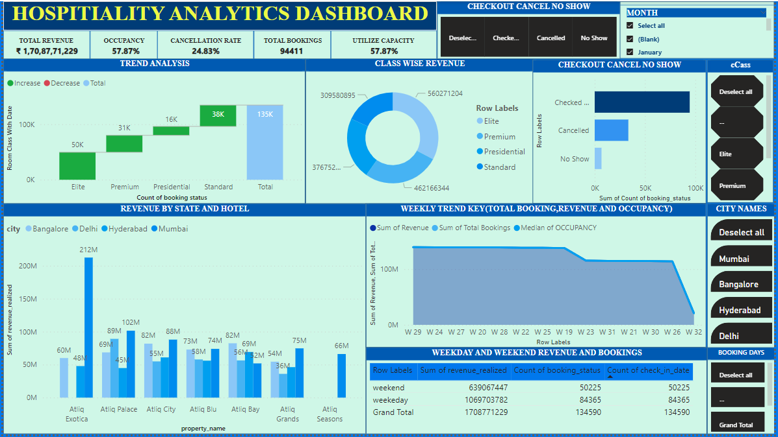
POWERBI DASHBOARD

Slide 9
Key Takeaways
Weekday Advantage: Weekday revenue and bookings exceed those of the weekend, suggesting business travelers may be a core customer segment.
High Cancellations: A 25% cancellation rate is notable; reducing this could significantly boost revenue and occupancy.
Top Performers: Atliq Exotica and Atliq Palace are leading in revenue, while Atliq Seasons is underperforming and may require targeted strategies.
Class Preference: Elite and Premium rooms are in high demand, representing the largest revenue segments.
Consistency in Revenue: Weekly revenue consistency points to stable market demand without significant seasonality impacts during the period analyzed.

Slide 10
THANK YOU !!

